Slide 1
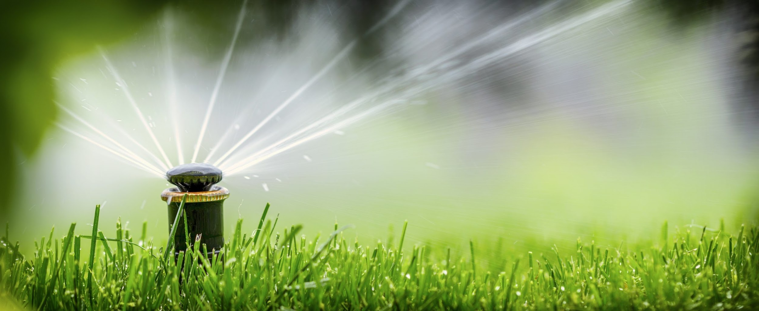

AUTOMATED IRRIGATION SYSTEM BY HYDROMATORS

Slide 2
TEAM MEMBERS
S.NO | NAME | ROLL NUMBER
1 | PONNANA VARAHALA NAIDU | 2110030062
2 | SRI HARSHA RAMPALLI | 2110030382
3 | K ESWAR PAVAN KUMAR | 2110030280
4 | J CHANDRASHEKAR | 2110030101

Slide 3
TABLE OF CONTENT
Introduction
Objective
Flow Chart
Methodology
Implementation
Result Analysis
Conclusion
Future Scope

Slide 4
INTRODUCTION
In present days, in the field of agriculture farmers are facing major problems in watering their crops, whether its drought or unavailability of soil fertility. It’s because they don’t have a proper idea about the availability of the power or the strength of their soil.
Even if it is available, they need to pump water and wait until the field is properly watered, which compels them to stop doing other activities – which are also crucial to them, and thus they lose their precious time and efforts.
But, there is a solution – “ An Automatic Plant Irrigation System “ not only helps farmers but also others for watering their gardens as well.
This automatic irrigation system senses the moisture content of the soil and automatically switches the pump when the power is on

Slide 5
OBJECTIVE
Making watering system automated.
Ensure enough moisture is essential for plant growth.
Making sure the soil is strong enough to make the plants sprout healtily.
Cool the soil to provide suitable surroundings.
To reduce the cost of labor.
Saving time is one of the significant purposes of this project.
To save the plants from being rotten because of excess water or other pests like rats.

Slide 6
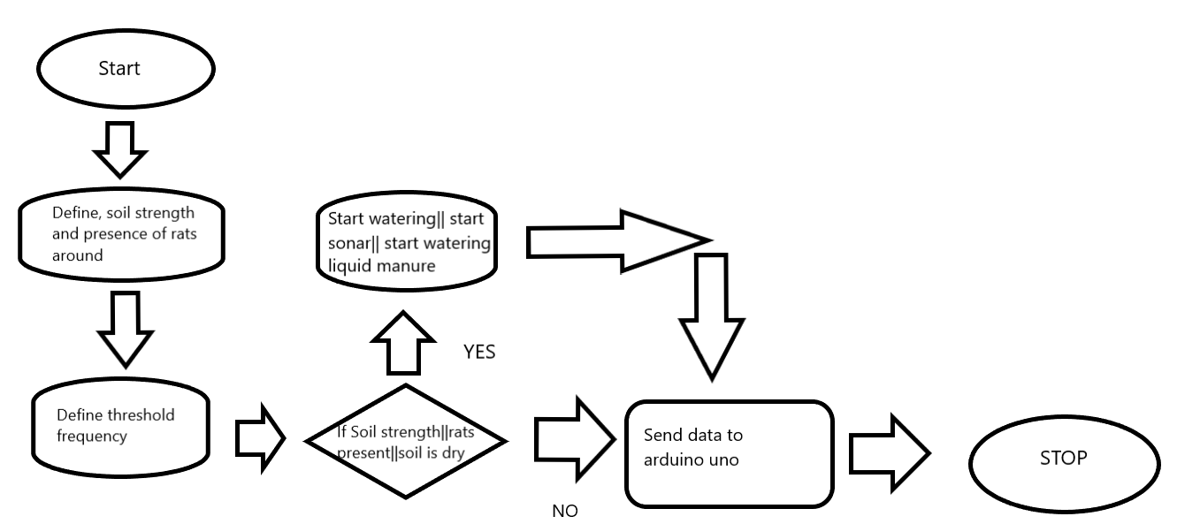
FLOWCHART

Slide 7
METHODOLOGY
Automated plant watering system is programmed using Arduino IDE software. Arduino microcontroller checks soil moisture level, soil fertility level and presence of rats , if high, triggering a water pump on until sensor reaches a threshold. After this, the system will re-check the soil moisture between periodic intervals to see if you need to maintain it. If everything is good to go, its going to wait for 10 minutes.
The system responds appropriately by watering the soil with the exact amount of water/liquid manure required and then shuts down the water supply when the required amount of soil fertility and moisture is achieved.
Arduino is an open-source electronics platform based on easy-to-use hardware and software. Arduino boards can read inputs - light on a sensor, a finger on a button, or a Twitter message - and turn them into an output - activating a motor, turning on an LED, publishing something online.

Slide 8
IMPLEMENTATION
Automated plant watering system is programmed using Arduino IDE software. Arduino microcontroller checks soil moisture level, if low, triggering a water pump on until sensor reaches threshold.
We will implement the system while re-check the soil moisture between periodic intervals to see if you need more water.
You can power the Arduino board using a 7V to 12V wall wart or plug-in adaptor or solar panel. You need a separate 12V battery or power supply or solar panel for the pump motor.
A contact soil sensor is used in this project because it has to check soil moisture to measure the electrical conductivity.
The moisture sensor provides an analogue output, which can easily be interfaced with Arduino.
The program is written in Arduino programming language. The code is well commented and is easy to understand.

Slide 9
Program implementation,
The program in the Arduino reads the moisture value from the sensor every seconds. If the value reaches the threshold value, the program does the following things like:
It moves the servo motor horn, along with the water pipe fixed on it, toward potted plant, whose moisture level is less than the predetermined/ threshold level.
It starts the motor pump to supply water to the plant for a fixed period of time and then stops the water pump.
Water pump is used to perform a specific task of artificially pumping. It can be controlled by an electronic microcontroller. It can be on 1 triggered by sending the signal and turned off as needed. Artificial process is called Water Pumping Station.

Slide 10
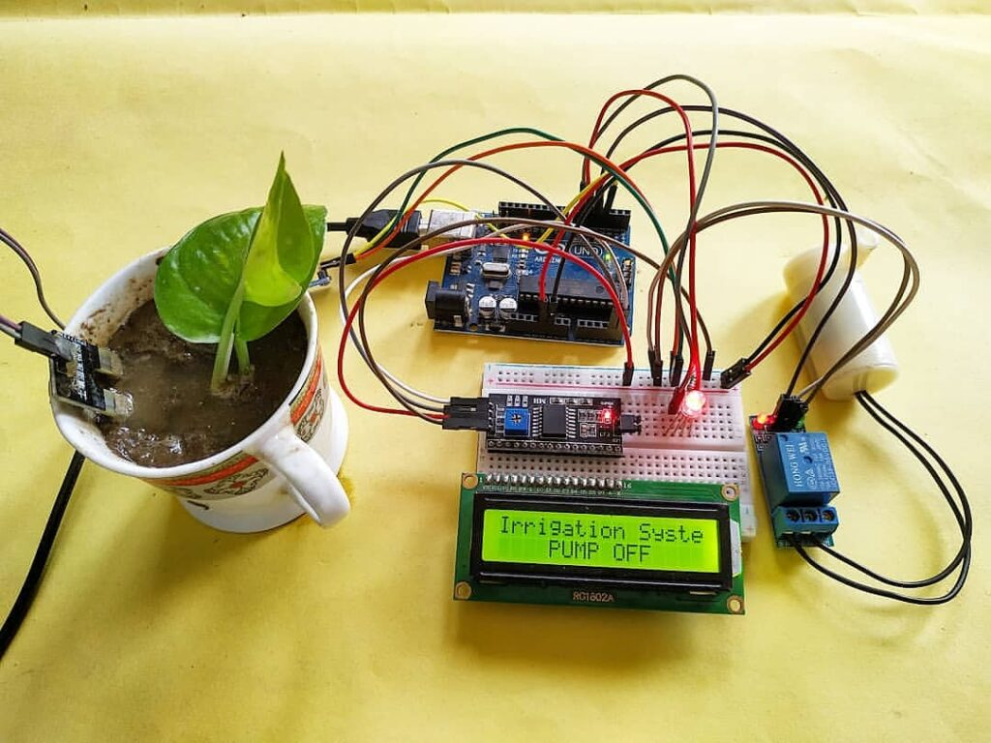
RESULT ANALYSIS
From this work, we can control the moisture content of the soil of cultivated land. According to soil moisture, the water pumping motor is turned on or off via the relay automatically. This saves water, while the water level can be obtained in a preferred aspect of the plant, thereby increasing the productivity of crops.
The proposed work minimizes the efforts of major agricultural regions.
Using this sensor, we can see whether the soil is wet or dry. If it is dry, the motor will automatically start pumping water.

Slide 11
CONCLUSION
Automatic system using a microcontroller, moisture sensor, and other electronic tools were been developed.
It was observed that the proposed methodology controls the moisture content of the soil of cultivated land.
The motor automatically starts pumping water if the soil is dry and needs water and stops when the moisture content of the soil is maintained as required.

Slide 12
FUTURE SCOPE
This Automated plant watering system extends watering time for plants, and provides ideal growth condition.
It saves time and timer delay as per the environmental condition can be added for automatic watering.
It can provide high accuracy water supply and avoid water from wastage, Due to automatically handling, user requires less man power.
This smart irrigation system can be adjusted and modified according to the changing environment.

Slide 13


